Slide 1
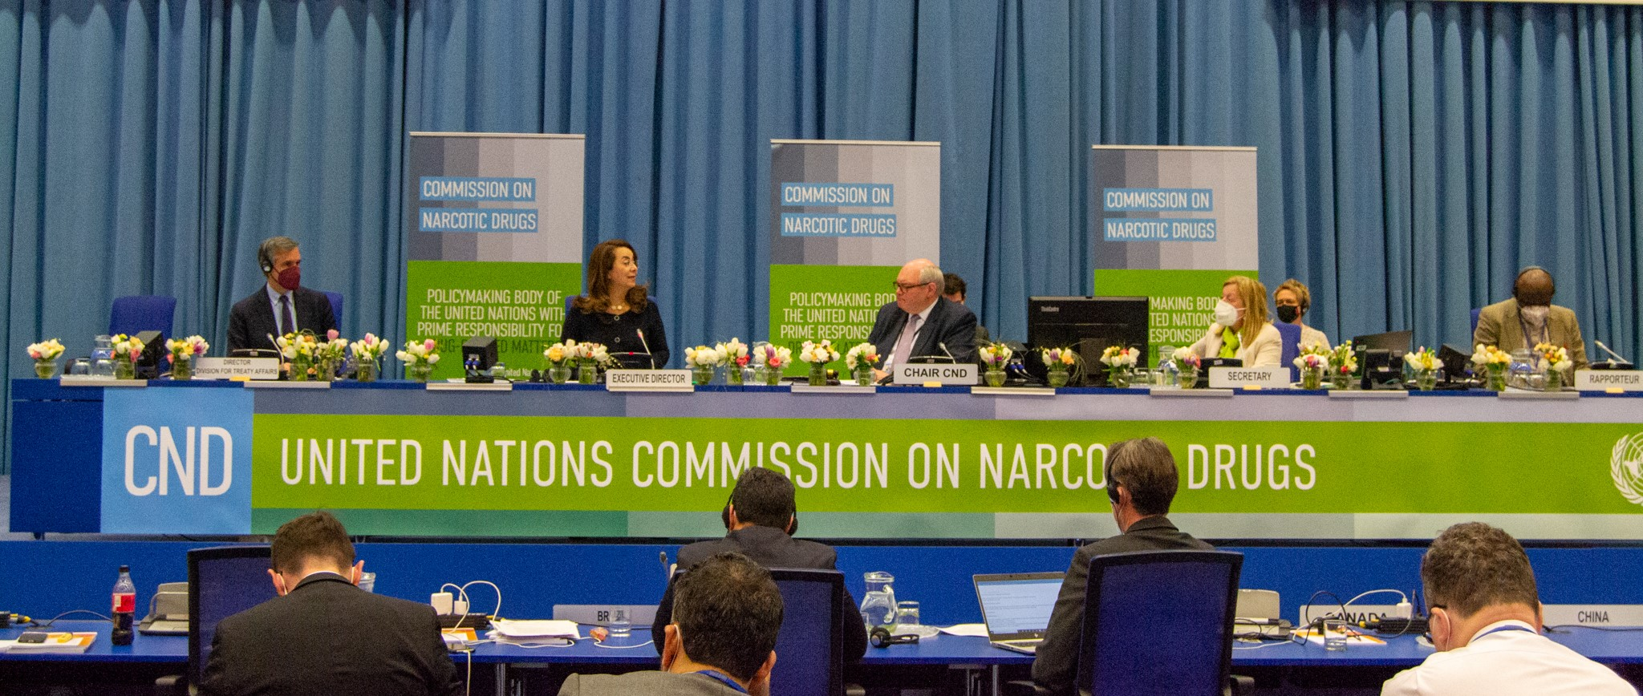
ECONOMIC AND SOCIAL COUNCIL MANAGEMENT SEGMENT MEETING
Item 19: Social and Human Rights Questions, (d): Narcotic drugs
8 June 2022
H.E. Mr. Ghislain D’Hoop
Chair of the Commission on Narcotic Drugs at its sixty-fitfh session

Slide 2
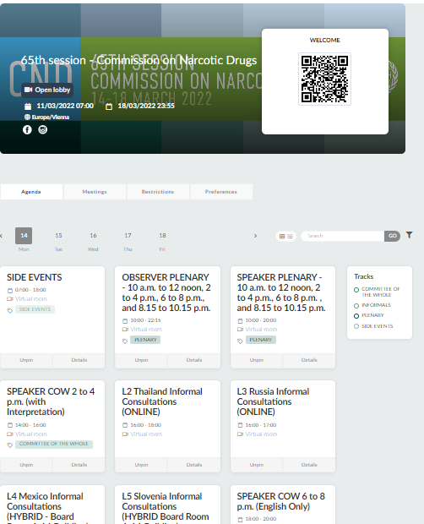
1350 PARTICIPANTS
16 INTERGOVERNMENTAL ORGANIZATIONS
120 SIDE EVENTS
80 NGOs
132 STATES
4 RESOLUTIONS AND 6 DECISIONS
7 UN BODIES AND AGENCIES
65th session: 14-18 March 2022

Slide 3
RESOLUTIONS ADOPTED AT THE 65th CND
65/1
Promoting alternative development as a development-oriented drug control strategy, taking into account measures to protect the environment
65/2
Strengthening international cooperation to address the links between illicit drug trafficking and illicit firearms trafficking
64/3
Intensifying efforts to address the diversion of non-scheduled chemicals frequently used in the illicit manufacture of drugs and the proliferation of designer precursors
64/4
Promoting comprehensive and scientific evidence-based early prevention

Slide 4
DECISIONS ADOPTED AT THE 65th CND
Schedule I of the 1961 Convention
Brorphine
Metonitazene
Schedule II of the 1971 Convention
Eutylone
Table I of the 1988 Convention
4-AP
1-boc-4-AP
Norfentanyl
SAVE THE DATE: 28 JUNE 2022
Special commemorative event at the occasion of the United Nations International Day against Drug Abuse and Illicit Trafficking and Launch of the 2022 World Drug Report

Slide 5
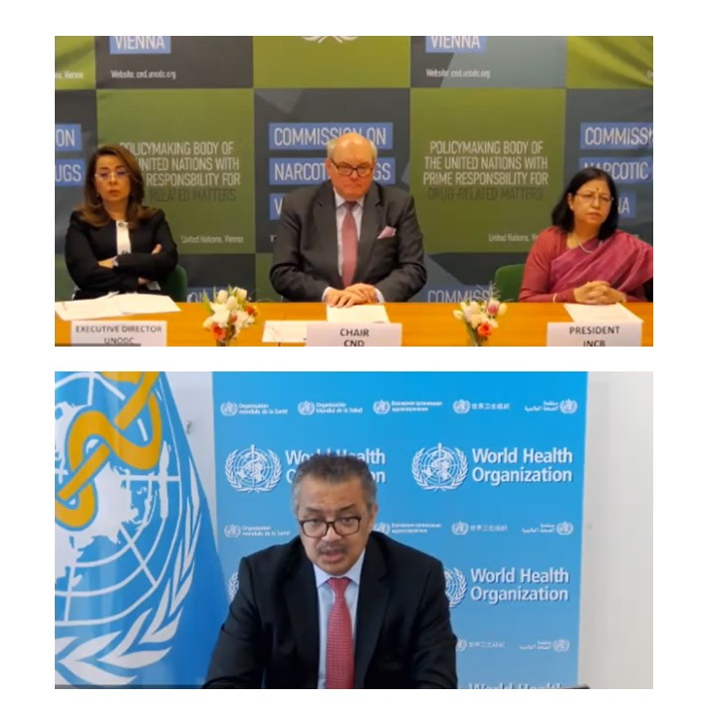
INITIATIVE ON enhancing access to and Availability of controlled substances for medical and scientific purposes - #NoPatientLeftBehind
Bring together key stakeholders to exchange on good practices and challenges
raise awareness to enhance implementation of policy commitments in this field
EVENTS AND SOCIAL MEDIA CAMPAIGNS throughout the 65th session, including a Special Event on 8 June 2022, 13.15 onwards, CR 3

Slide 6
CONTINUING OPEN DIALOGUE MULTI-YEAR WORKPLAN BEYOND 2019
FOLLOW-UP TO THE 2019 MINISTERIAL DECLARATION
March 2019 – Adoption of the Ministerial Declaration
2019, 2020, 2021, 2022 – Thematic Discussions
2029 – Review progress in implementing all international drug policies
2024 – Mid-term review
Member States committed to fostering a broad, transparent and inclusive discussion involving all relevant stakeholders
Thematic Discussion 2022
Responses not in conformity with the three international drug control conventions and not in conformity with applicable international human rights obligations pose a challenge to the implementation of joint commitments based on the principle of common and shared responsibility.

Slide 7
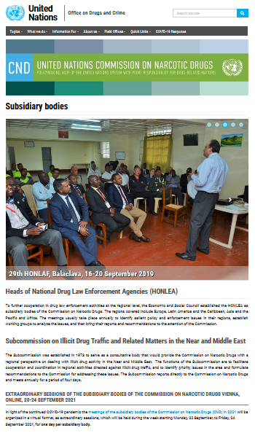
SUBSIDIARY BODIES CND: HONLEAs
2021 EXTRAORDINARY SESSIONS (online), 20-24 September 2021
2022 SESSIONS are planned again in-person in the regions

Slide 8
Review of Subsidiary Bodies
Launch of the review by the ECOSOC President
CND-CCPCJ dialogue with Member States
CND assessment submitted
2nd trilateral meeting
ECOSOC briefing to Member States (New York)
Management Segment
29 Nov 2021
Jan 2022
Mid-April 2022
8-9 June 2022
1
2
3
4
5
6
7
April / May 2022
Dec 2021
Feb 2022
Start of review, collection of preliminary feedback on the review concept
1st trilateral meeting: CND Chair, CCPCJ Chair & ECOSOC Vice-President
Consultations with Member States
(New York)

Slide 9
High-level Political Forum of ECOSOC
5-7 & 11-15 July 2022 with
Ministerial Segment from 13-15 July 2022
Theme
SDGs under Review
Building back better from COVID-19 while advancing the
CND Input
full implementation of the 2030 Agenda for Sustainable Development
HLPF side event
Submitted to ECOSOC in March 2022

Slide 10
Thank you!
@ungass2016
www.unodc.org/2019MDFollow-Up
http://cnd.unodc.org
@CND_tweets

