Slide 1
Artificial Intelligence
for Sustainable Development Goals
Jim Balsillie
Founder & Chair, Centre for International Governance Innovation (CIGI)
“Without proper controls, AI systems can amplify, perpetuate, or exacerbate inequitable or undesirable outcomes for individuals and communities. With proper controls, AI systems can mitigate and manage inequitable outcomes.”
NIST. Jan. 2023. “Artificial Intelligence Risk Management Framework (AI RMF 1.0) (https://doi.org/10.6028/NIST.AI.100-1)

Slide 2
Shift From Tangibles to Intangibles
Figure 1. Shift from Tangibles to Intangibles
Components of S&P Market Value
Figure 2. Tangible & Intangible Capital, S&P 500
1975-2024, constant USD trillion at 2024 prices
Knowledge Based Economy (KBE)
Data-Driven Economy (DDE)
Machine Knowledge Capital (MKC)
Knowledge Based Economy (KBE)
Data-Driven Economy (DDE)
Machine Knowledge Capital (MKC)
Source: Ocean Tomo
Source: https://papers.ssrn.com/abstract=4762228
The Magnificent Seven (Apple, Alphabet, Amazon, Meta, Microsoft, Nvidia, Tesla) have a combined market cap of ~$9.5 trillion of which ~90% is composed of intangibles.

Slide 3
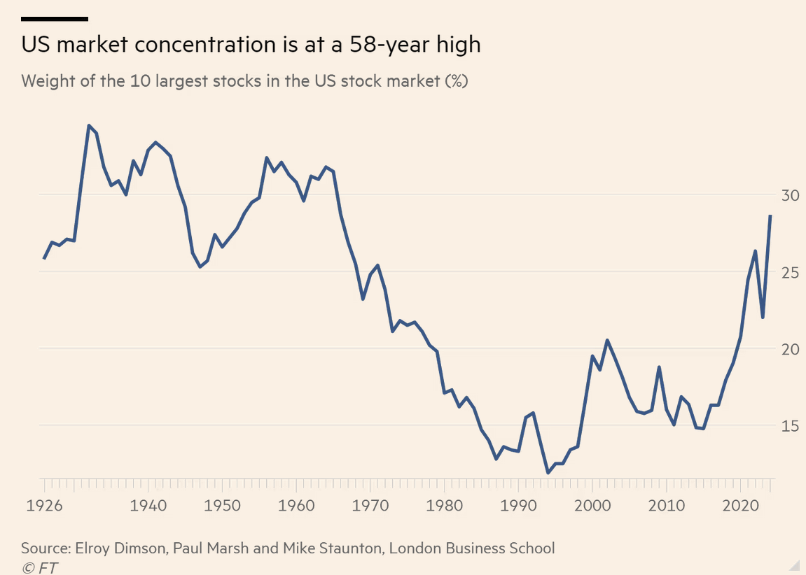
The Data-Driven Economy’s Structural Characteristics Lead to Natural Monopolies
1. Economies of Scope
2. Economies of Scale
3. Network Externalities
4. Information Asymmetries

Slide 4
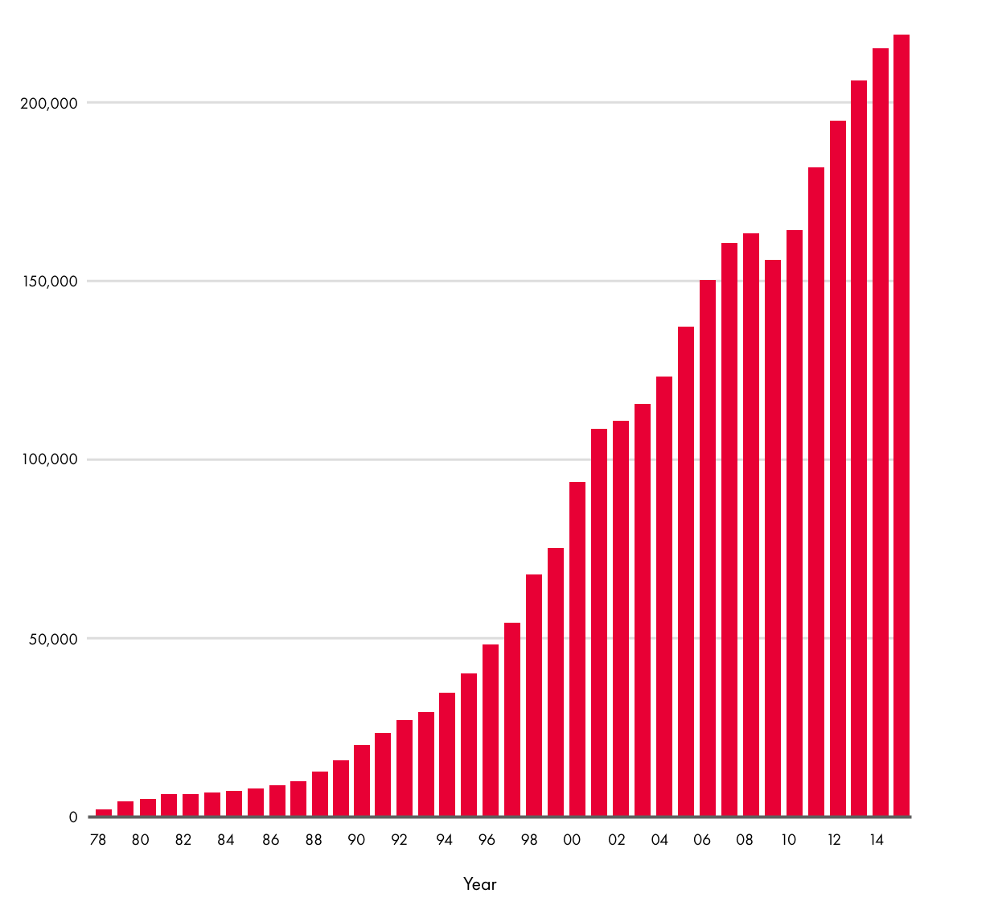
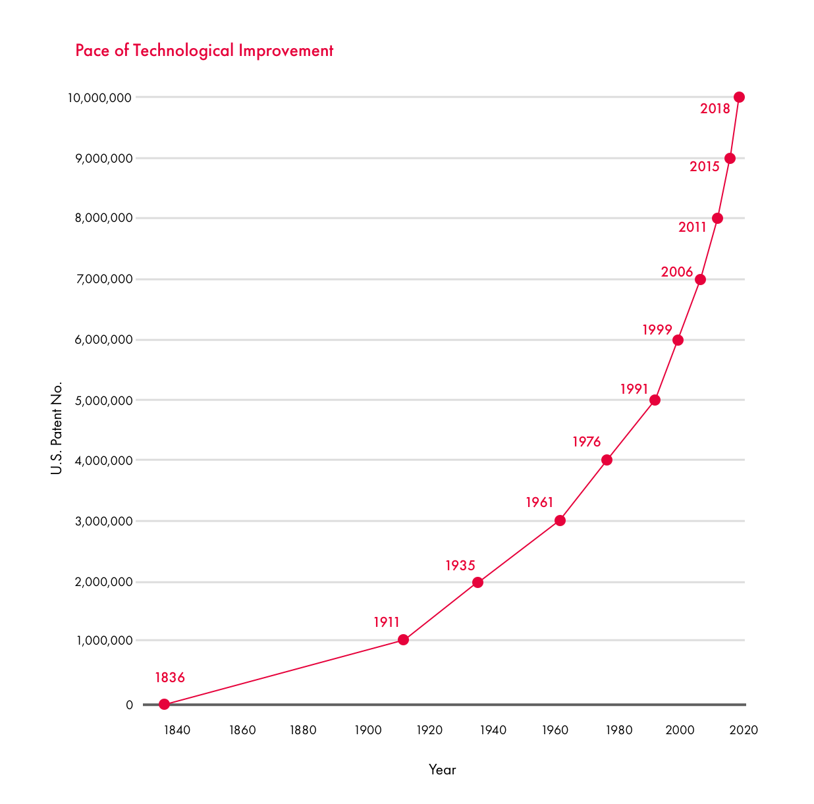
Patent Cooperation Treaty – Patent Filings
USPTO – Patent Filings
PCT Applications Filed
“Patents are the most concrete and comparable measure of
innovative output over countries and time.”
The IT Revolution and the Globalization of R&D (http://www.nber.org/papers/w24707)
Source: http://www.wipo.int/pct/en/3million/index.html

Slide 5
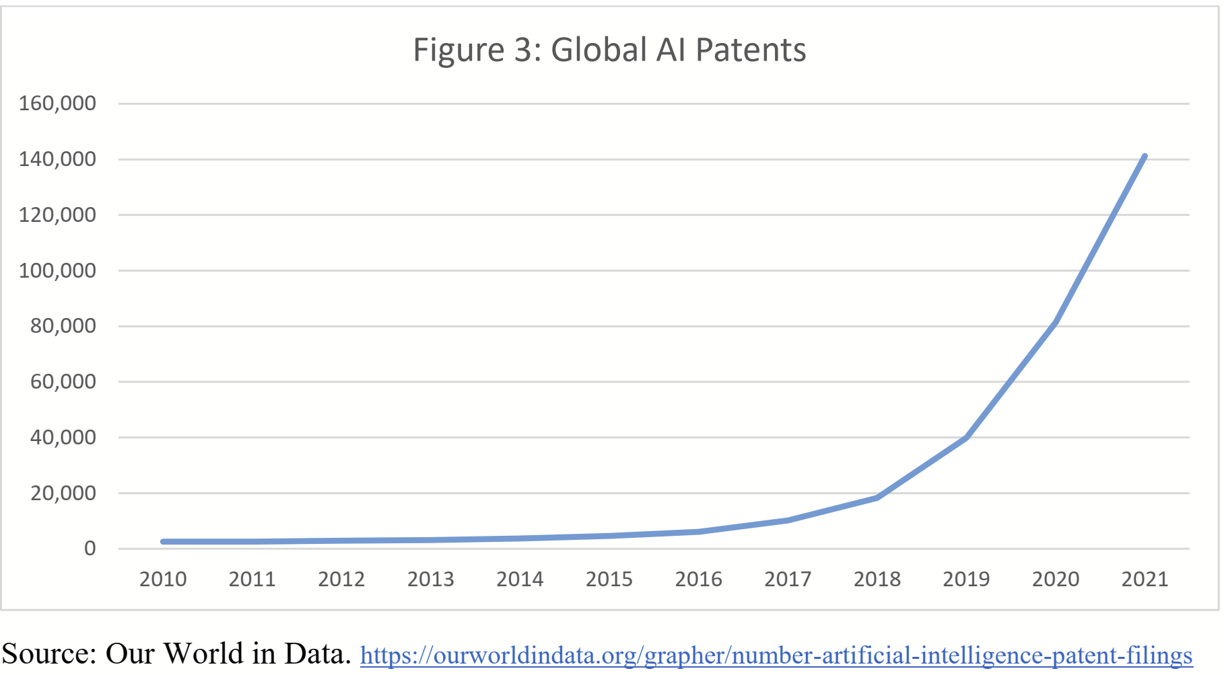
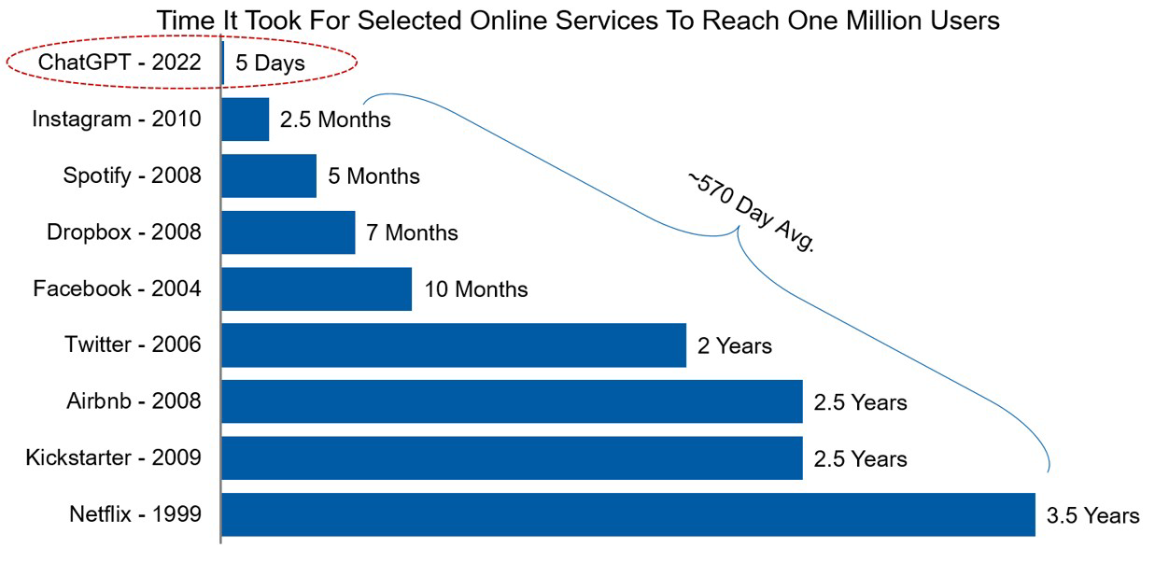
The Rapid Acceleration of AI
The Acceleration of Global AI Patent Filings
The Accelerating Pace of Innovation and Adoption
Source: Company data, Statista, Morgan Stanley Research
“However, while there might be positive effects stemming from the globalization of IPR appropriation in terms of stimulus to inventive activities, there are doubts about whether this delivers the expected results in terms of equality and shared prosperity … after TRIPS, patenting in Latin America became even more concentrated in foreign applicants. Thus, rather than contributing to higher innovation rates by developing country firms, these agreements appear instead to reinforce patent monopolies by leading international firms.”
https://www.sciencedirect.com/science/article/pii/S0048733323002202?via%3Dihub

Slide 6
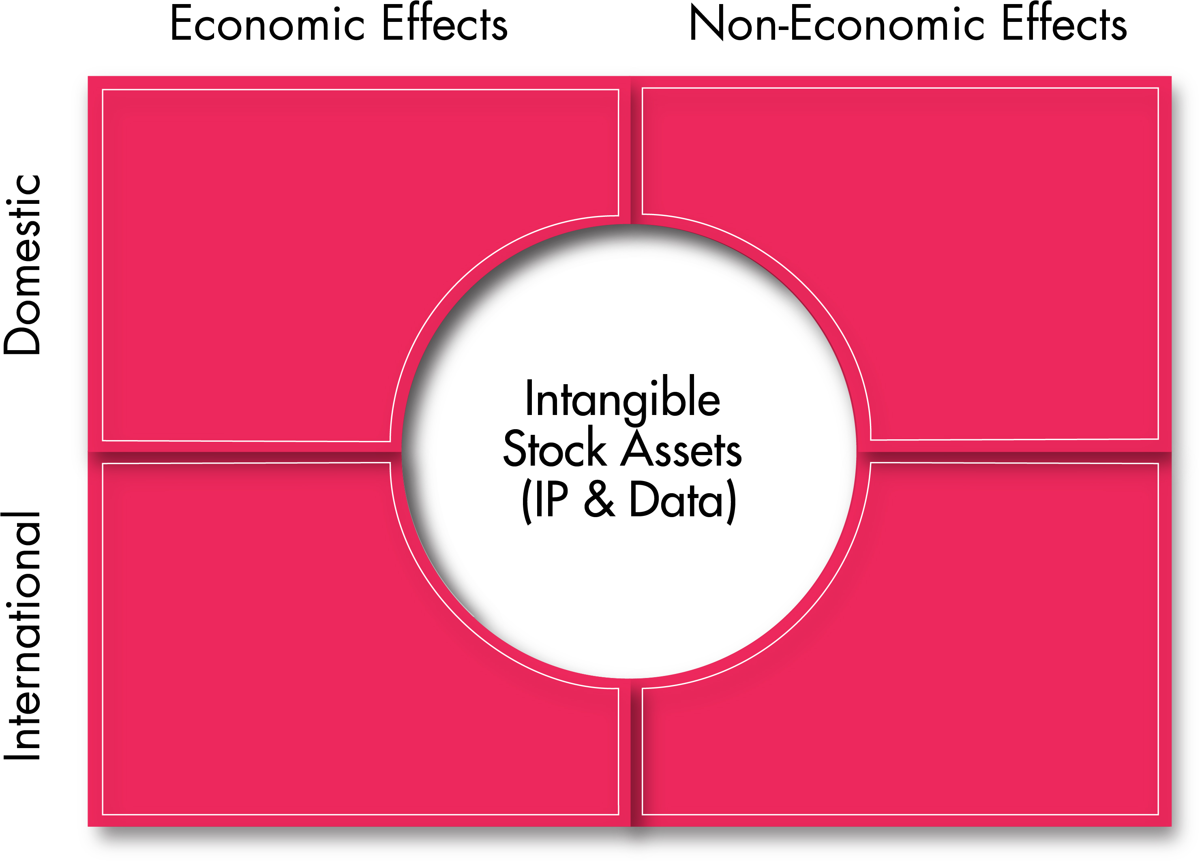
The Dual Use Nature of Intangible Assets
Data and AI Governance for the Intangible Economy
CORE RESPONSIBILITIES
PUBLIC SAFETY &
NATIONAL
DEFENCE
ECONOMIC
PROSPERITY
PUBLIC
HEALTH
Cross-Cutting
Issues of
Data & AI
INSTRUMENTAL ENDS
SOVEREIGNTY &
CONTROL
DEMOCRACY
VALUE ORIENTED OBJECTIVES
COMPETITION
ALGORITHM
ETHICS
CYBER
SECURITY
PRIVACY

Slide 7
The Ceaseless Impact of Data, Digital Technology and AI on Knowledge
Warning signs have long been there…
...now we have the harmful effects
“When the founding fathers established our constitutional system of government, they based it on their fundamental belief in the sanctity of the individual.... They understood that self-determination is the source of individuality, and individuality is the mainstay of freedom... Recently, however, technology has begun to develop new methods of behavior control capable of altering not just an individual's actions but his very personality and manner of thinking... Concepts of freedom, privacy and self-determination inherently conflict with programs designed to control not just physical freedom, but the source of free thought as well... The question becomes even more acute when these programs are conducted, as they are today, in the absence of strict controls. As disturbing as behavior modification may be on a theoretical level, the unchecked growth of the practical technology of behavior control is cause for even greater concern.”
Subcommittee on Constitutional Rights of the Committee on the Judiciary, United States Senate Ninety-Third Congress, Second Session, November 1974
Source: https://files.eric.ed.gov/fulltext/ED103726.pdf
Democracy Erosion
Increased Inequality
Falsehood/Propaganda
Child Mental Illness
Identity Theft/Fraud
Social Polarization
Cybersecurity Risks
Market
Monopolization
Loss of Privacy/Private Sphere
Human Commodification
“Data is not the new oil – it’s the new plutonium. Amazingly powerful, dangerous when it spreads, difficult to clean up and with serious consequences when improperly used.”
Jim Balsillie, International Grand Committee on Big Data, Privacy and Democracy. May 28, 2019

Slide 8
Knowledge rights for a Digital Information Era
THE RIGHT TO:
REALITY (freedom from systemic corruption of knowledge and perception)
KNOWLEDGE (freedom from illegitimate concentration or control of knowledge)
AGENCY (freedom from systemic manipulation of individual thoughts and behavior)
PRIVACY (protect the inalienability of the private sphere)
SELF REPRESENTATION, IDENTITY (control your likeness and who you are to the world)
COMMUNITY AND CULTURE (freedom from systemic manipulation of collective behavior)
POLITICAL PARTICIPATION AND DEMOCRATIC SELF-GOVERNANCE (unfettered participation in democratic processes)

Slide 9
Policy Framework for the Knowledge-based, Data-driven Era
Address Together with Coherent National Strategies
Security in a Digital Era
Capture Economic Value
Sovereignty
(Democracy, Privacy, Child Mental Health, etc.)
National Security Carve-out Expanded
GATS/FTA Compliance
Jim Balsillie
IMF Keynote Nov.2018
https://www.imf.org/en/Videos/view?vid=5970062973001

Slide 10
Create a “Digital Stability Board” that supports national approaches with advocacy for regulatory cooperation and coherence on best practice standards, including:
Safety, Fairness, and Transparency
Privacy Rights and Data Management
Intellectual Property Rights
Auditability and Auditing
Address the need for fair diffusion given the nature of winner-takes-most economics and its crosscutting effects that lead to strategic behaviour (that embeds interests and norms)
Avoid the gaslighting of:
Proposing a global moratorium on coding
Seeking global consensus prematurely
Focusing on existential risks (undefinable, unquantifiable, indeterminate)

